Slide 1
A Simple Intro to
Neural Machine Translation
In 60 minutes or less...

Slide 2

Disclaimers
If you get lost anywhere at any point, don’t worry!
You DON’T need to code along, but please feel free to.
Much like you, I’m very low on sleep!

Slide 3

What is NMT?
Family of language translation models.
Often an encoder-decoder model
Source language is encoded and then decoded to the target language.
Adrian’s NMT

Slide 4
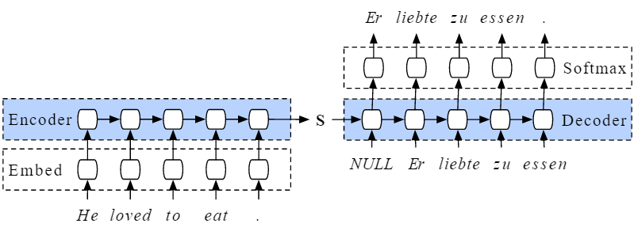
A Brief Overview of Encoder-Decoder models
Source language sentences get encoded into some latent space.
From the latent space, a decoder model decodes into the target language.
There are more advanced models but this is a good base.

Slide 5
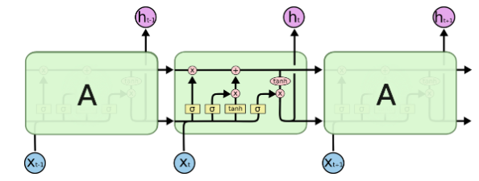
A Brief Overview of LSTMs
Used for capturing sequential information.
Avoids the exploding weight problem.
Uses a forget gate to choose which previous members of the sequence will influence the prediction of the next.
In general answers: If t-2, t-1, and t happened in this order, the t+1 will be...

Slide 6



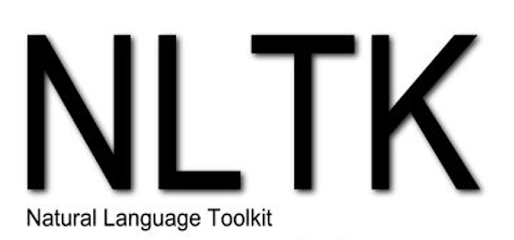
Let’s Get to the Code!
Here’s our basic tech stack for most deep learning problems with a flair of NLP:

Slide 7

Where to Go From Here
Improving the current model. The initial model is not well configured.
Learning different language translations.
Adding extra bells and whistles like Attention (more state-of-the art)

Slide 8
Thanks for coming!
Hopefully I didn’t go over time...

